Slide 1
Binary Addition & Subtraction

Slide 2
Binary Addition
A | B | OUT
0 | 0 | 0
0 | 1 | 1
1 | 0 | 1
1 | 1 | 10

Slide 3
Example
101 + 101

Slide 4
Example
10001 + 11101

Slide 5
Example
10111 + 110001

Slide 6
Binary Subtraction
A | B | OUT
0 | 0 | 0
1 | 0 | 1
0 | 1 | 1(Borrow 1 from next digit)
1 | 1 | 0

Slide 7
Example
1 0 1 0 – 101

Slide 8
Example
110101 – 100101

Slide 9
Example
101011 – 111001

Slide 10
What about this?
101 - 1010

Slide 11
Negative Number Representation
-ve sign (Sign Magnitude)
1’s compliment
2’s compliment

Slide 12
Example

Slide 13
Questions
1011011 − 10010 = ?
1010110 − 101010 = ?
1000101 − 101100 = ?
100010110 − 1111010 = ?
101101 − 100111 = ?
1110110 − 1010111 = ?

Slide 14
Questions
1011011 − 10010 = 1001001
1010110 − 101010 = 101100
1000101 − 101100 = 11001
100010110 − 1111010 = 10011100
101101 − 100111 = 110
1110110 − 1010111 = 11111

Slide 15
Limitations of Signed Magnitude
For 0, there are two representations: -0 and +0 which should not be the case as 0 is neither –ve nor +ve.
Out of 2^n bits for representation, we are able to utilize only 2^{n-1} bits.
Numbers are not in cyclic order i.e. After the largest number (in this, for example, +7) the next number is not the least number (in this, for example, +0).

Slide 16
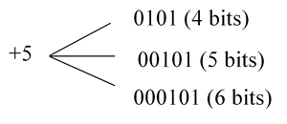

Contd.
For negative numbers signed extension does not work.

Slide 17
Limitations of 1’s Compliment
For 0, there are two representations: -0 and +0 which should not be the case as 0 is neither –ve nor +ve.
Out of 2^n bits for representation, we are able to utilize only 2^{n-1} bits.

Slide 18
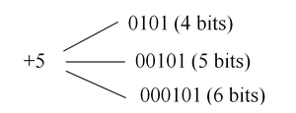
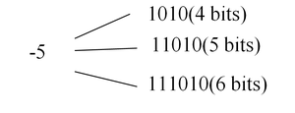
Signed Extension in 1’s Compliment
You need to add 0/1 in the MSB.

Slide 19
Homework
Design a circuit for 4-bit addition and subtraction of 2 binary numbers. A control bit will decide whether addition or subtraction needs to be performed. Consider an additional bit for signed representation.
Repeat the above using 1’s compliment method.
Repeat the above using 2’s compliment method.

Slide 20
Exception 1
0 = 00000000 (twos complement)
Bitwise complement = 11111111
Add 1 to LSB + 1
Result 100000000
Overflow is ignored, so:
- 0 = 0

Slide 21
Exception 2: bit pattern 1{0}{1,n}
-128 = 10000000 (twos complement)
Bitwise complement = 01111111
Add 1 to LSB + 1
Result 10000000
So:
-(-128) = -128 X
Monitor MSB (sign bit)
It should change during negation

Slide 22
Overflow
If two numbers are added, and they are both positive or both negative, then overflow occurs if and only if the result has the opposite sign.

Slide 23
Multiplication Basics
0 × 0 = 0
0 × 1 = 0
1 × 0 = 0
1 × 1 = 1

Slide 24
Example 1
Solve 1010 × 101

Slide 25
Example 1
Solve 1010 × 101
1010
101
-------
1010
0000X
1010XX
----------
110010

Slide 26
Example 2
Solve 1011.01 × 110.1

Slide 27
Example 2
Solve 1011.01 × 110.1
1011.01
110.1
------------
101101
000000X
101101XX
101101XXX
---------------
1001001001

Slide 28
Self Practice
Solve 10001 x 111
Solve 10101 x 110
Solve 11111 x 10000

Slide 29
Multiplication

Slide 30
Multiplication of –ve numbers
What if you multiply 1001 (-7) and 1101 (-3)?

Slide 31
Conversion to +ve number and decide sign
What if you multiply 1001 (-7) and 1101 (-3)?

Slide 32
Sign-Extend Method (2’s Compliment Multiplication)
What if you multiply 1001 (-7) and 1101 (-3)?

Slide 33
Motivation for Booth’s Algorithm
The important thing to note about two’s complement multiplication is that the number of additions/subtractions that we do is identical to the number of 1’s in the multiplier.
So, a multiplier with ten 1’s will require ten addition/subtraction operations, whereas a multipler with only a single 1 will only require one addition/subtraction operation.

Slide 34
Background
Number 5 in binary using 4 bits
0101
Number -5 in binary using 4 bits 2’s compliment
1011
How to justify the above using place value logic?

Slide 35
Contd.
2’s compliment of 5: 1011
Sometimes the –ve 1 is represented as one bar.
We take one bar to simply mean -1. We will call this balanced ternary representation.
Thus 7 represented as 0111 can also be represented as 100one bar.
-2^3 | 2^2 | 2^1 | 2^0
1 | 0 | 1 | 1

Slide 36
Contd.
How does this help?
0111 for each 1 we need to shift and add while for each 0 we need only to shift. Since the shift calculators were fast, it was better to have multiple zeros than ones.

Slide 37
Booth’s Algorithm
Booth algorithm gives a procedure for multiplying binary integers in signed 2’s complement representation in efficient way, i.e., less number of additions/subtractions required.
It operates on the fact that strings of 0’s in the multiplier require no addition but just shifting.
Also, a string of 1's in a multiplier bit weight 2^{k} to weight 2^{m} that can be considered as 2^{k+ 1} - 2^{m}.

Slide 38
Contd.
As in all multiplication schemes, booth algorithm requires examination of the multiplier bits and shifting of the partial product. Prior to the shifting, the multiplicand may be added to the partial product, subtracted from the partial product, or left unchanged according to following rules:
1. The multiplicand is subtracted from the partial product upon encountering the first least significant 1 in a string of 1’s in the multiplier
2. The multiplicand is added to the partial product upon encountering the first 0 (provided that there was a previous ‘1’) in a string of 0’s in the multiplier.
3. The partial product does not change when the multiplier bit is identical to the previous multiplier bit.

Slide 39
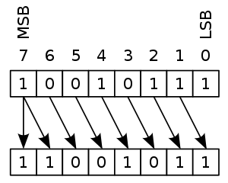
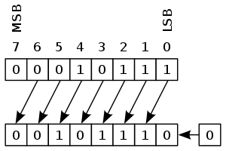
Arithmetic Shift (ashr)
Right Shift
Left Shift

Slide 40
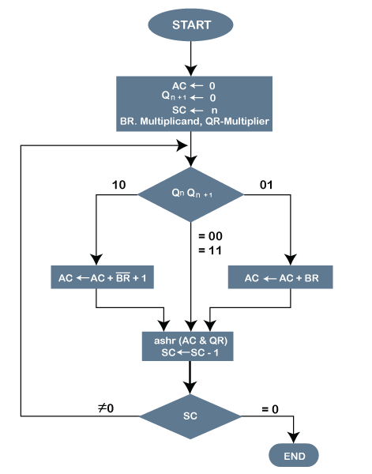
Flowchart

Slide 41
Example
A numerical example of booth’s algorithm is shown below for n = 4. It shows the step by step multiplication of -5 and -7.
-6 x -7
BR QR
Multiplicand Multiplier

Slide 42
Execution
BR = -5 = 1011,
BR' = 0100, <-- 1's Complement (change the values 0 to 1 and 1 to 0)
BR'+1 = 0101 <-- 2's Complement (add 1 to the Binary value obtained after 1's compliment)
QR = -7 = 1001 <-- 2's Complement of 0111 (7 = 0111 in Binary)
The explanation of first step is as follows:
AC = 0000,
QR = 1001,
Qn+1 = 0,
SC = 4

Slide 43
Contd.
Qn Qn+1 = 10
So, we do AC + (BR)'+1, which gives AC = 0101
On right shifting AC and QR, we get AC = 0010, QR = 1100 and Qn+1 = 1

Slide 44
Contd.
OPERATION | AC | QR | Qn+1 | SC
 | 0000 | 1001 | 0 | 4
AC + BR’ + 1 | 0101 | 1001 | 0
ASHR | 0010 | 1100 | 1 | 3
AC + BR | 1101 | 1100 | 1
ASHR | 1110 | 1110 | 0 | 2
ASHR | 1111 | 0111 | 0 | 1
AC + BR’ + 1 | 0100 | 0111 | 0
ASHR | 0010 | 0011 | 1 | 0

Slide 45
Solution
Product = AC QR
Product = 0010 0011 = 35

Slide 46
Example 2
-4 X -5
OPERATION | AC | QR | Qn+1 | SC

Slide 47
Example 2
-4 X -5
OPERATION | AC | QR | Qn+1 | SC
 | 0000 | 1011 | 0 | 4
AC + BR’ + 1 | 0100 | 1011 | 0
ASHR | 0010 | 0101 | 1 | 3
ASHR | 0001 | 0010 | 1 | 2
AC + BR | 1101 | 0010 | 1
ASHR | 1110 | 1001 | 0 | 1
AC + BR’ + 1 | 0010 | 1001 | 0
ASHR | 0001 | 0100 | 1 | 0

Slide 48
Binary Division
A | B | A/B
0 | 0 | Meaningless
0 | 1 | 0
1 | 0 | Meaningless
1 | 1 | 1

Slide 49
Example 1
(01111100)₂ / (0010)₂

Slide 50
Solution 1
(01111100)₂ = (1111100)₂ = 124₁₀
(0010)₂ = (10)₂ = 2₁₀
You will get the resultant value as 62 when you divide 124 by 2.
So the binary equivalent of 62 is (111110)₂
.(111110)₂ = 62₁₀

Slide 51
Solution 2
By Long Division
1111100
10

Slide 52
Solve
Solve using the long division method: 101101 ÷ 101

Slide 53
2’s Compliment Division (repeated subtraction)
Step 1: Check for signs. Based on sign, decide the sign of the quotient.
Step 2: Subtract the divisor from the dividend using 2’s compliment addition (remember that the final carries are discarded).
Step 3: Repeat until you get zero remainder or a value less than the divisor’s magnitude.

Slide 54
Example 1
dividend 1111100
divisor 0000100
2’s compliment 1111100
Repeat 2’s compliments addition till termination

Slide 55
Contd.
dividend 1111100
2’s compliment 1111110
1111010
1111000
1110110
1110100
1110010
1110000
1101110
1010000
1001110
1001100
1001010
1001000
1000110
1000100
1000010
1000000
0111110
0111100
0111010
0111000

